Slide 1
Senior Design Team 16
Midterm Peer Review
Ethan Houts, Thomas Kivlahan, Mensanh Namessi, CJ Reitz,
& Evan Rosonke
Notes:
Welcome to our lightning talk. This will be about Requirements & Engineering Standards; both in general and how and how they will potentially apply to our project.

Slide 2
Introduction
The goal of our project is to reduce temperature related dangers for individuals with lower limb paralysis through temperature sensors. This enables users to be aware of their body temperature in areas they cannot feel, guarding against risks associated with extreme temperatures. The sensors are placed in an insole-like feature that user places in his/her sock. A microcontroller processes the sensor data, which is then wirelessly communicated to a smartphone app via Bluetooth. This app not only displays real-time temperature readings but also alerts users when concerning temperatures are occurring. Our initiative goes beyond mere temperature monitoring; it's about empowering those with paralysis to have better control over their health and well-being.
Notes:
Thomas record

Slide 3
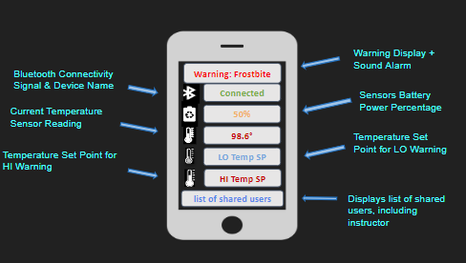
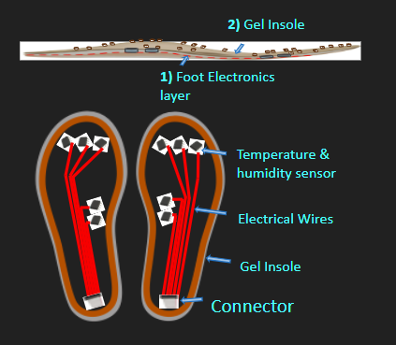
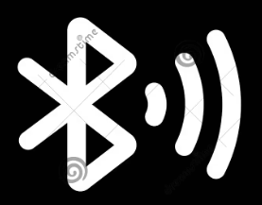
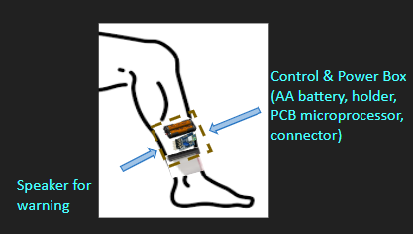
Detailed Design
Notes:
Evan Record
Our design consists of 3 major parts, 2 of them being hardware and one being software. Starting from the bottom up we have our gel insole layer which contains the temperature sensors to read in the temperature from the bottoms of the feet, the gel insole will be just thick enough to contain the sensors and wires. From there our wires will run back to our control box which will contain our battery pack and our microcontroller, the microcontroller we are using is a Raspberry Pi Pico W as is contains bluetooth capability as well as 3 Analog to Digital converters for our temp sensors. We are power the raspberry pi using a battery pack containing two AA batteries.

Slide 4
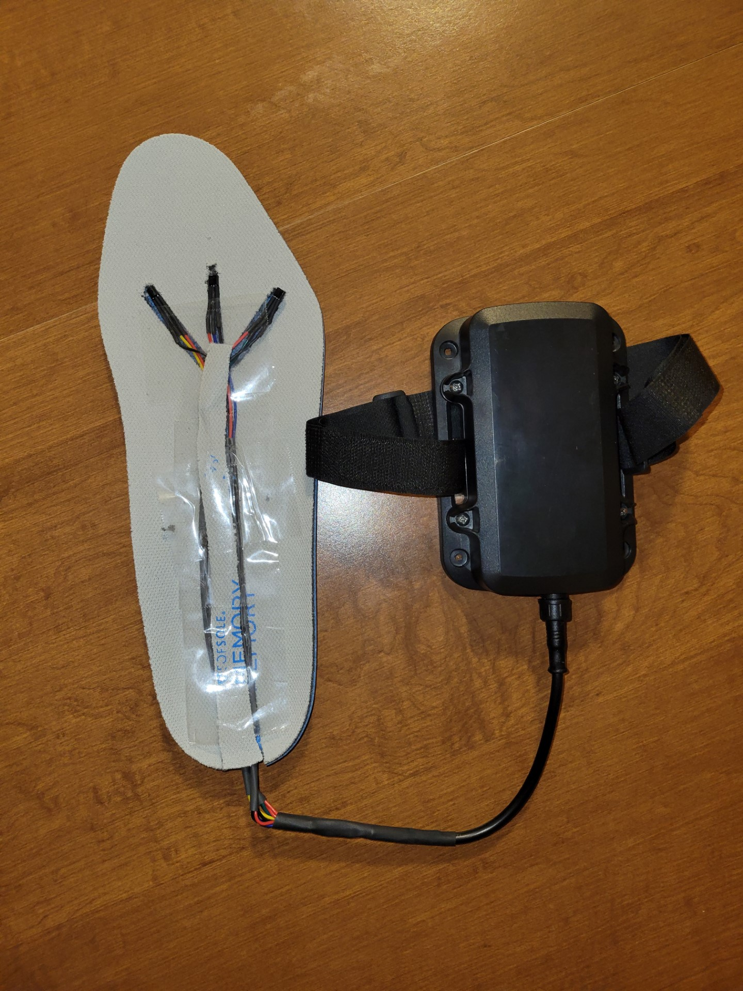
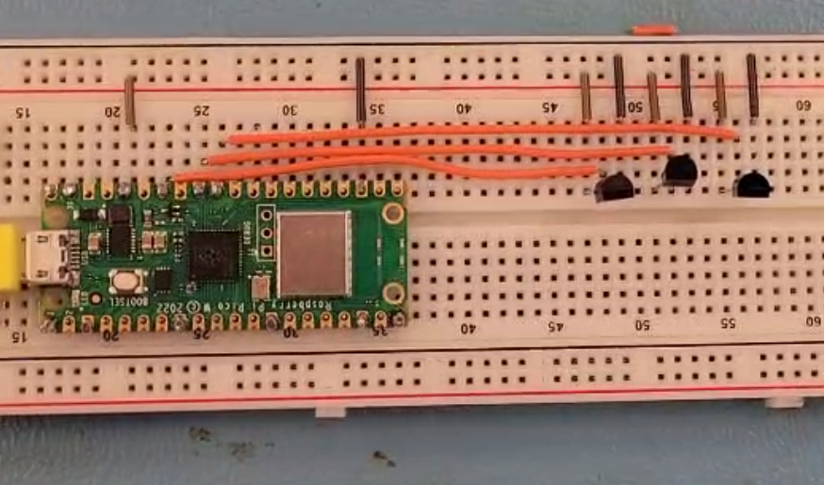
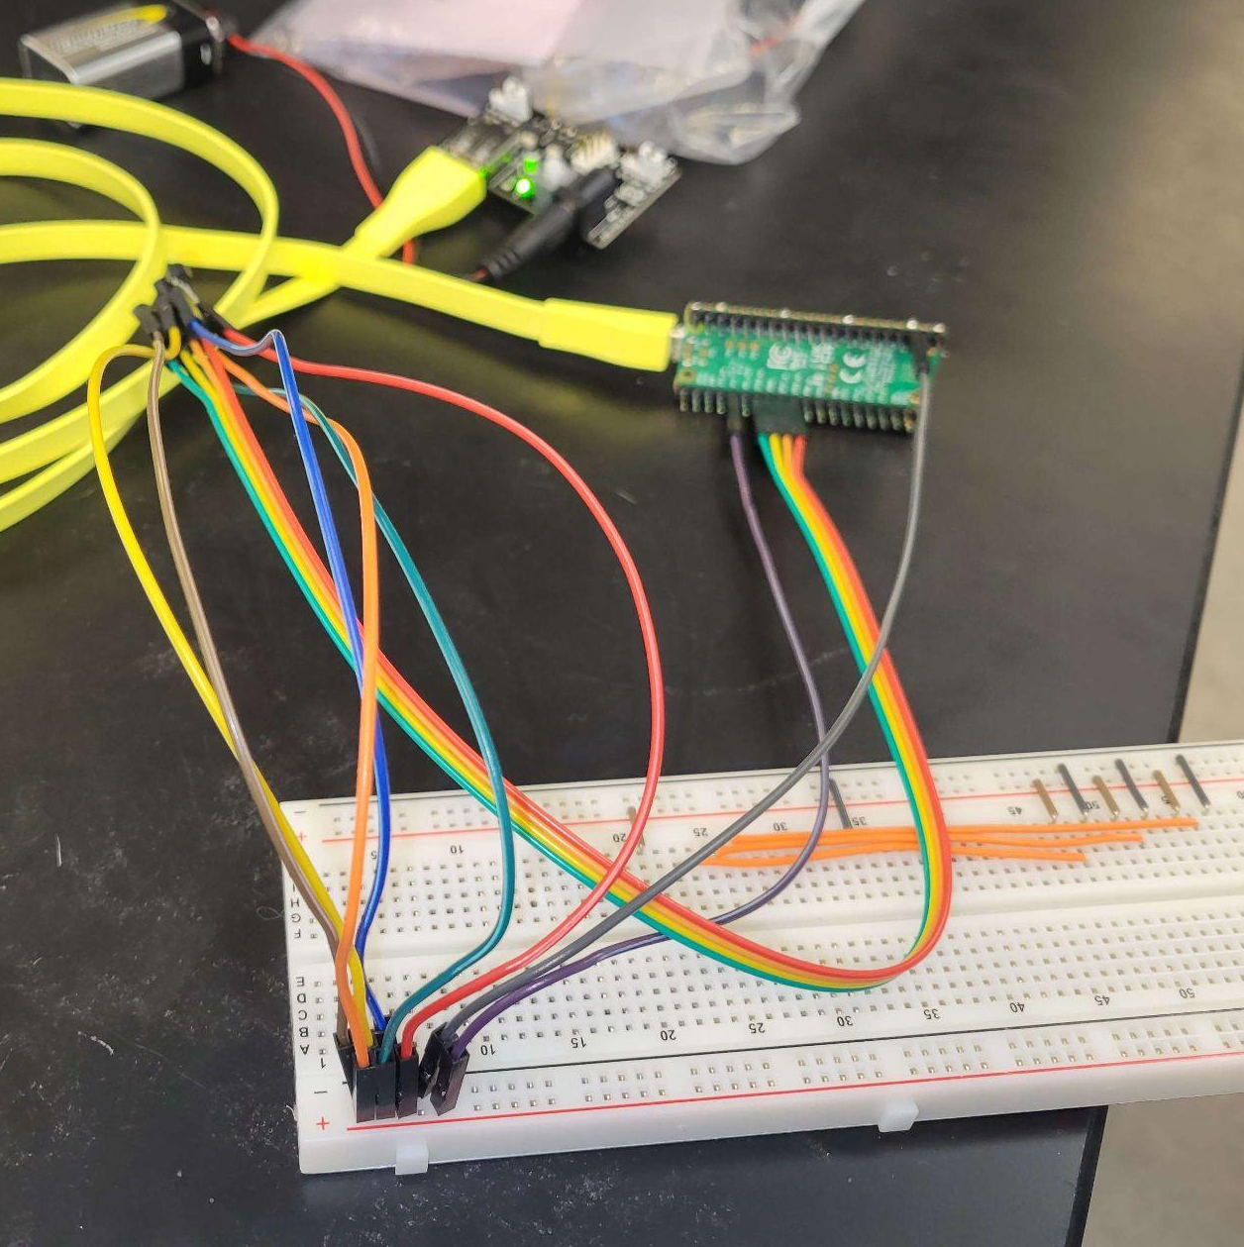
Work Progress - Hardware
Notes:
Evan record
While our over all process started by picking out what hardware we were going to use and the limitations that came along with that for example our raspberry pi pico only having 3 ADCs allowing us only 3 temp sensors, We first started to implement our design on the breadboard being powered by the computer from there we move it off the breadboard, wiring the sensors to the breadboard and converting it to battery power still making sure the readings were actuarte using the phone application. And then we started packaging out application, we have settled on a our ankle enclosure but are still working toward creating our own gel insole in order to package the sensors and wires into a more rigid package. Some of our next steps are:
creating that new gel insole
Doing some in house testing making sure all components are functioning as they should
Creating 4-6 prototypes to be sent and tested by our clients

Slide 5
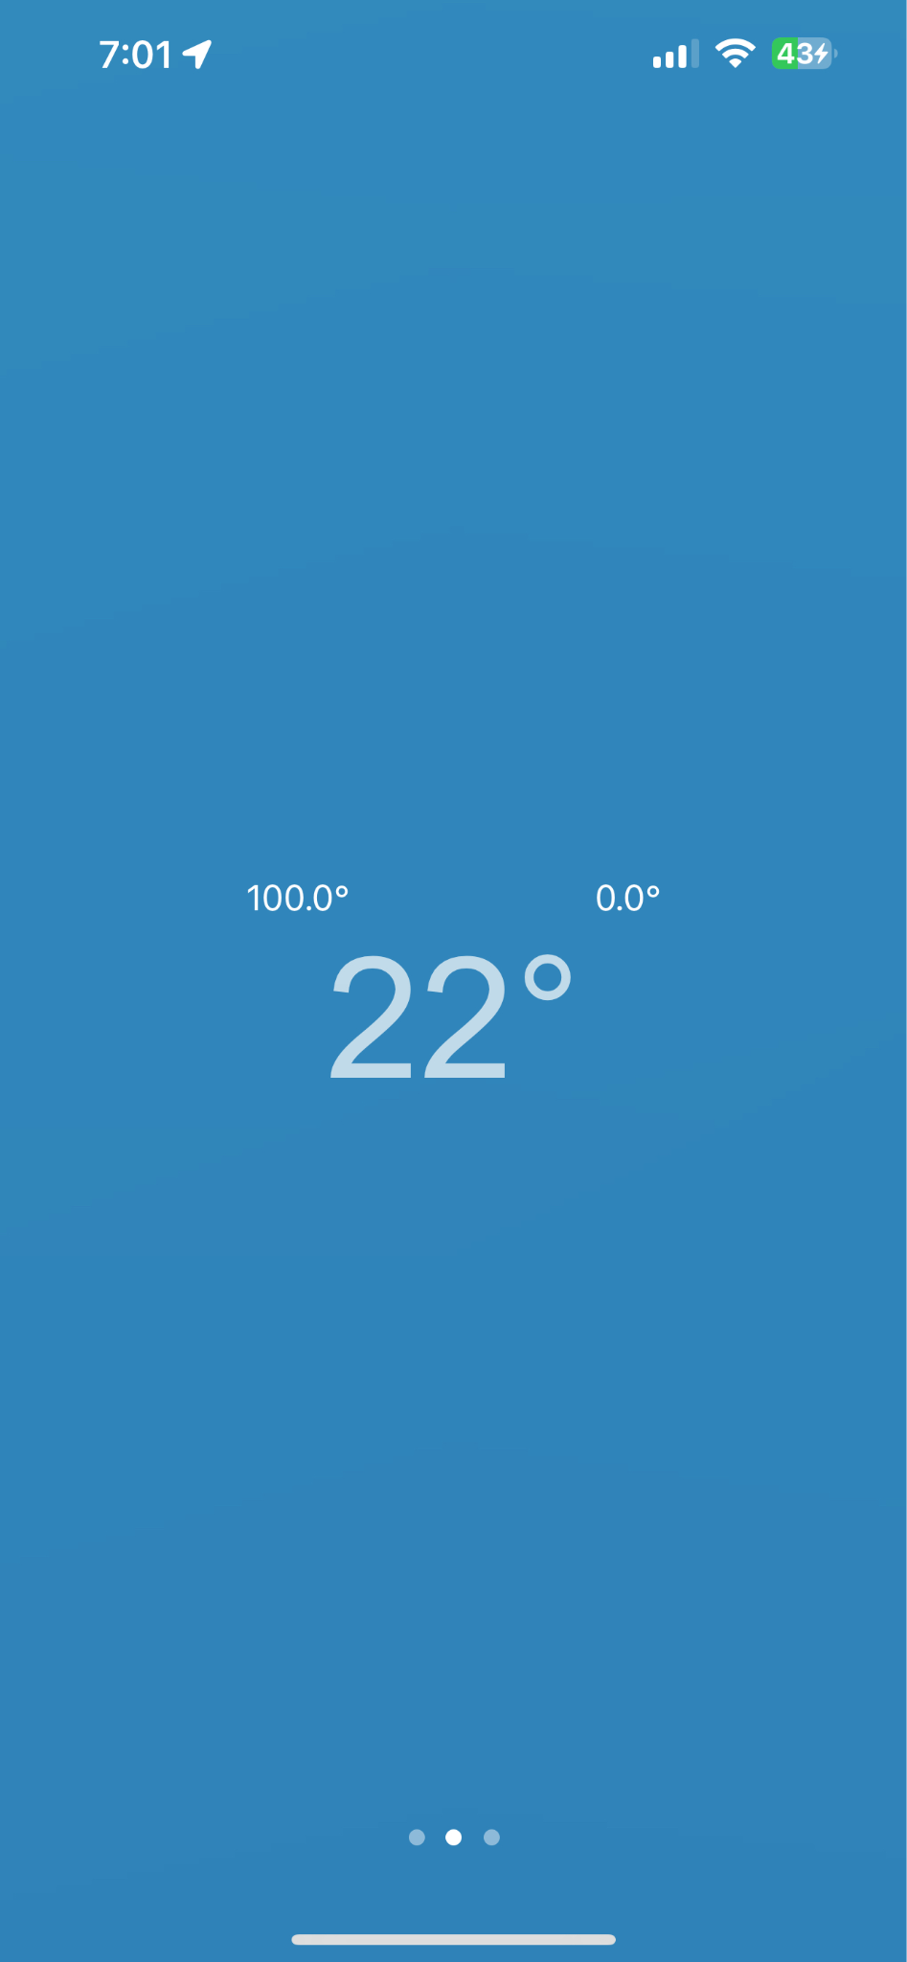
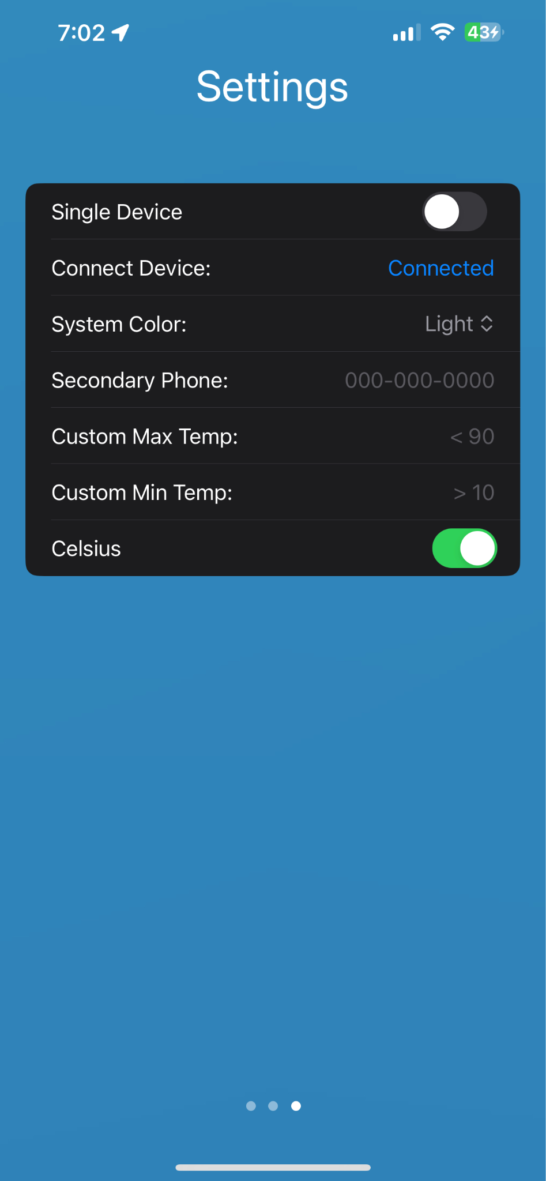
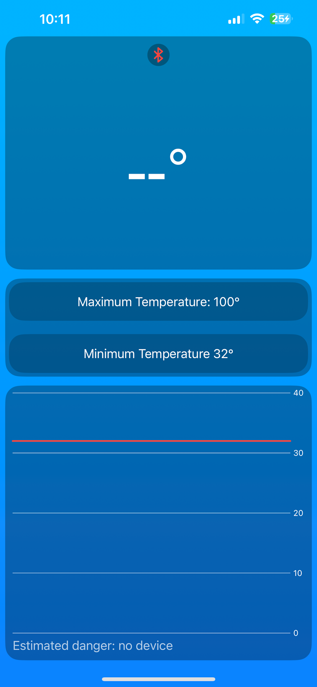
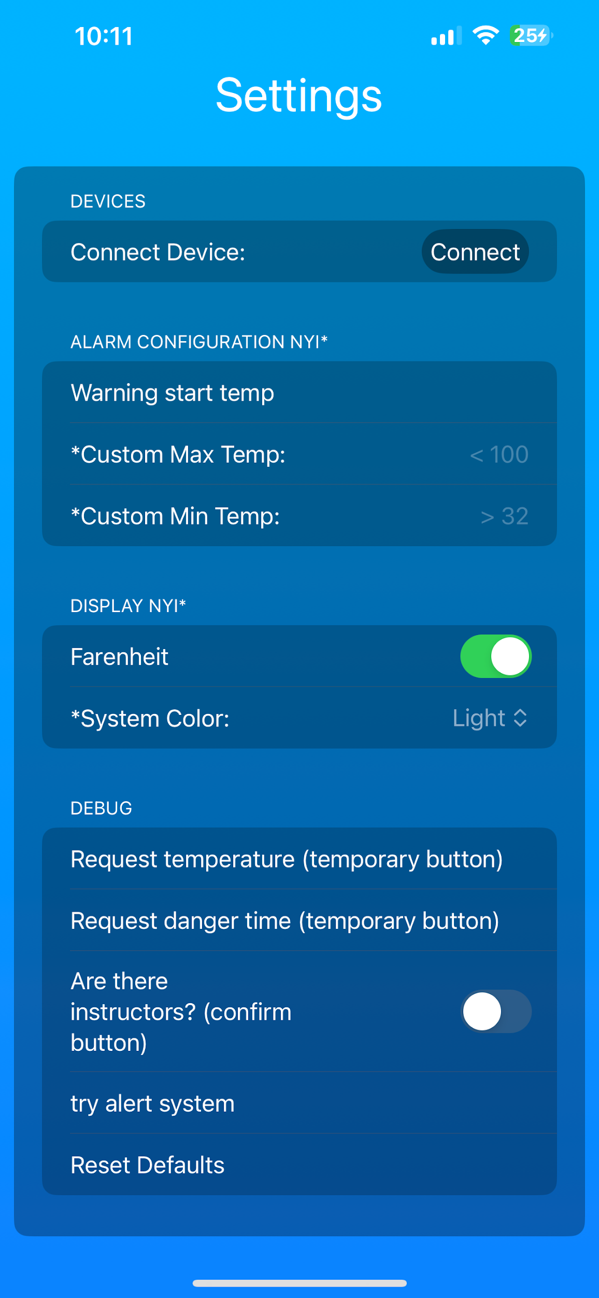
Work Progress - Software
Notes:
Ethan Record:
Since last semester our app has gotten several new features and a face lift. The app now supports connecting of up to 5 of our devices at once, which is overkill and is the hardware limitation of the bluetooth chips, Push notifications for when the temperature is getting out of the safe range, graphs that dynamically update with how many devices are connected and display the data that is incoming from the sensors. A protocol has also been put in place to more easily send different types of data between the phone and our device, and theoretically it would be easy for another device using the same api to also function with the application should that be an option in the future.

Slide 6
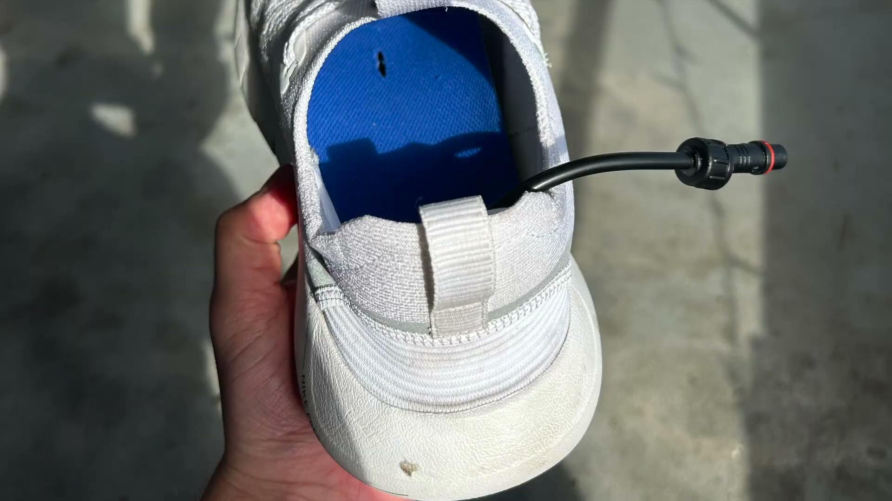
Demonstration of Current Design

Slide 7
Challenges and Solutions
Package choice for the electronics
We have chosen our packaging using the following factors: how comfortable it is to wear, and how easy it is to waterproof the device.
Creating an interface for the temperature sensors that is comfortable
We currently have three different styles of interfaces in the works: an off the shelf shoe insole with embedded sensors, a custom gel made in house, and a super slim material that was originally meant to prevent blisters.
Accuracy of the result after testing
Thorough testing of each solder connection has increased the accuracy of the sensors between devices.
Adapting the ios app to android (still ongoing)

Slide 8
Conclusion
Even though it was a little bit challenging, this project is a really nice project that cover different materials we have learnt during our undergraduate journey. It particularity of building staff from software to hardware give us some perspective about the professional engineer carrier project. Each of us get more knowledge by sharing, analyzing and contributing to the project realisation.
Notes:
Mensanh

